Slide 1
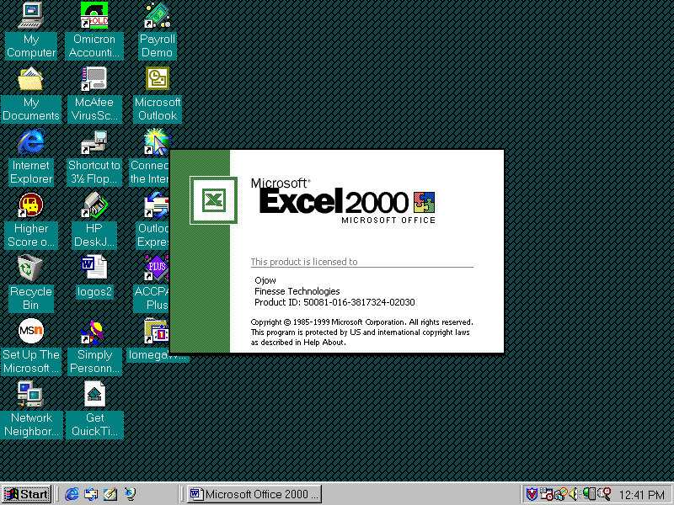
SPREADSHEETS
WITH

Slide 2
Advantages of a Spread Sheet
It is much more easier to use computerized spreadsheet such as Excel than to perform manual calculations
A spreadsheet is a general-purpose tool that can be used to solve a wide variety of problems any information that can be presented as columns and rows.
Reduces the drudgery of calculations
Reduces the chances of making error especially computational errors
Frees user time to concentrate on problem solving
Allows users to examine alternative solutions.
Produces quicker results.

Slide 3
Disadvantages of a Spread Sheet
Incase of a mistake in a value, this affects the whole worksheet
Wrong formula will lead to incorrect results
When the sheet is too long it is not possible to view it at ago.

Slide 4
Microsoft Excel Components and Features
A spreadsheet program is and application that manipulates numbers and string data in rows and columns and has the following features:
Cell – Is an intersection of a row and a column. It is the basic storage in Ms. Excel. It can contain various types of data such as Numeric data (e.g 2005) or Character data (e.g Pauline). A cell referenced by its address which consists of the column number and row letter. E.g the first cell is A1, is in the first column A and row 1.
Worksheet – Are sheets that contain rows and columns forming cells in which the user can enter and store data. They can be referred to as pages in a workbook. They are usually numbers as Sheet1, Sheet2, ….Sheet n. It is made up of 16384 rows and 256 Colulmns.

Slide 5
Workbook – A workbook is the main file of Ms. Excel program and usually contains a number of worksheets. By default an Ms. Excel workbook must have 16 worksheets. You can navigate to various worksheets by using the sheet tab.
Workspace – It contains realated workbooks e.g all workbooks that contain data of all the departments of a store.
Shared workbooks – This is a group of workbook which enable you to use a workbook from any location on the network. Sharing workbooks helps in storing all data in one workbook that can ber referred to easily.
Linking Worksheets – This Ms. Excel feature enables you to work on a number of worksheets at the same time.
Charts – This is an Ms. Excel facility used to represent data in form of a graph especially for summary purpose. It enables you to graphically represent data in a worksheet.

Slide 6
Management of data – This is made possible by using various features like creation of database outlining.
Range Finder – Uses colored coordinated frames to indicate the cells that are referenced in a given formula if the cell in which the results of the formula is displayed.
Data Validation – It helps in maintaining consistency in a shared workbook where a number of people use the shared workbook. You can also setup rules and specify a message for a cell or range of cells specifying the kind of data that has to be entered in a cell.
Track Changes – Allows you to trace changes made to the worksheet by various users in a workbook. This feature is useful when you are working on a shared workbook and want to find our about the modifications made by other users.

Slide 7
Autocorrect Spellchecker – Automatically corrects common typing, spelling and grammatical errors.
Page break Management – Automatically prints a worksheet that is larger than a page. You can specify which rows and columns are printed on the page by inserting horizontal and vertical page breaks respectively. Excel also provides a page breaks by dragging them to a different location in the worksheet/
Conditional Formatting – Is a feature that can apply formats to a cell or a range of cells if the condition specified in the cell is true. E.g you can specify that if the value in the cell is 8 then the colour will be green.

Slide 8
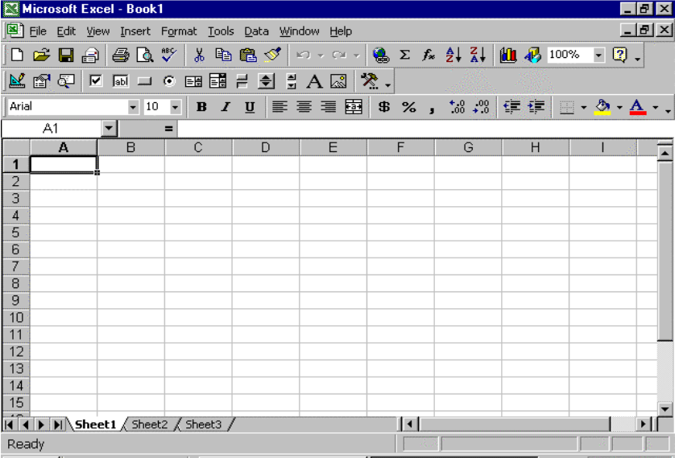

Slide 9
Calculating Quickly Excel
Excel is a spreadsheet program, designed to help you record, analyze and present quantitative information. With Excel you can track and analyze sales, organise finances, create budgets, and accomplish a variety of business tasks in a fraction of the time it would take using pen and paper. With Excel, you can create a variety of documents for analysis and record keeping, such as:
Monthly sales and expense reports.
Chart displaying annual sales data
An inventory of products.
A payment schedule for an equipment purchase.
The file you create and save in Excel is called a Workbook. It contains a collection of worksheets, which look similar to an accountant’s ledger sheets, but can perform calculations and other tasks automatically.

Slide 10
Selecting cells.
A cell is the intersection of a column and row. You must select a cell and make it active to work with it. A range is one or more selected cells that you can edit, delete, format, print, or use in a formula just like a single cell. The active cell has a dark border; selected cells have a light shading called a see-through selection. A range can be contiguous (all selected cells are adjacent) or noncontiguous (selected cells are not all adjacent). A range reference lists the upper – left cell address, a colon (:), and the Commas separate noncontiguous cells. For example, B4: D10, E7, L24.

Slide 11
Select a cell.
Click a cell to select it.

Slide 12
Select a Range
Click the first cell you want to include in the range.
Drag to the last cell you want to include the range. The upper – left cell of a selected range is active and others are highlighted.

Slide 13
Select a Noncontiguous Range
Click the first cell or select the first contiguous range you want to include.
Press and hold Ctrl while you click additional cells and select other ranges.

Slide 14
Working with Worksheets
Each new workbook opens with three worksheets (or sheets), in which you store and analyze values. You work in the active, or selected, worksheet. The default worksheet names are Sheet1, Sheet2, and Sheet3, which appear on the sheet tab, like file folder labels. As you create a worksheet, give it a meaningful name to help you remember it contents. The sheet tab size adjusts to fit the name’s length. If you work on a project that requires more than three worksheets, add additional sheets to the workbook so all related information is stored in one file.

Slide 15
Select a Worksheet
If necessary, click a sheet tab scroll button to display other tabs.
Click a sheet tab to make it the active worksheet.
To select multiple worksheets, press and hold Ctrl as you click other sheet tabs.

Slide 16
Name a Worksheet
Double – click the sheet tab you want to name.
Type a new name.
The current name, which is selected, is replaced when you begin typing.
Press Enter.

Slide 17
Insert a worksheet
Click the sheet tab to the right of where you want to insert the new sheet.
Click the Insert menu, and then Click worksheet.
A new worksheet is inserted to the left of the selected worksheet.

Slide 18
Delete a Worksheet
Click the sheet tab of the worksheet you want to delete.
Click the Edit menu, and then click Delete Sheet.
Click OK to confirm the deletion.

Slide 19
Entering Text and Numbers
Labels turn a worksheet full of numbers into a meaningful report by clarifying the relationship between the numbers. Labels are text or numbers that identify the data on the worksheet columns and rows; for example item or 3-27-200. An apostrophe (‘) before the number label, such as the year 2000, prevents Excel from using that number in any calculations. The PickList, a list of labels you entered previously, helps keep your labels consistent. Values are the numbers you want to use in calculations. You can enter values as whole numbers, decimals, or dates.

Slide 20
Enter a Text Label
Click the cell where you want to enter a text label.
Type a label.
A label can include uppercase and lowercase letters, spaces, punctuations, and numbers.
Click the Enter button on the formula bar, or press Enter.

